Slide 1
Enhancing the quality and transparency of health research through the use of reporting guidelines
Doug Altman
Centre for Statistics in Medicine, Oxford, UK
and EQUATOR Network

Slide 2
The impact of a research article
Scientific manuscripts should present sufficient data so that the reader can fully evaluate the information and reach his or her own conclusions about results
to assess reliability and relevance
Readers need a clear understanding of exactly what was done
Clinicians
Researchers
Systematic reviewers
Policy makers
…

Slide 3
Transparency and value
Research only has value if
Study methods have validity
Research findings are published in a usable form

Slide 4
What should be reported?
“Describe statistical methods with enough detail to enable a knowledgeable reader with access to the original data to verify the reported results.”
[International Committee of Medical Journal Editors]
A similar principle should extend to all study aspects
Selection of participants, Interventions, Outcomes etc
The goal should be transparency
Should not mislead
Should allow replication (in principle)
Can be included in systematic review and meta-analysis

Slide 5
What do we mean by poor reporting?
Mainly
Key information is missing, incomplete or ambiguous
Methods
Results
Also
Selective reporting
Whole or part of study
Misleading interpretation
etc

Slide 6
Evidence of poor reporting
There is considerable evidence that many published articles omit vital information
Hundreds of reviews of published research articles
We often cannot tell exactly how the research was done

Slide 7
Reports of RCTs indexed on PubMed
7

Slide 8
Reporting of research
“In 37% of papers patient numbers were inadequately reported; 20% of papers introduced new statistical methods in the 'results' section not previously reported in the 'methods' section, and 23% of papers reported no measurement of error with the main outcome measure.”
[Parsons et al, J Bone Joint Surg Br 2011]

Slide 9
Case-control studies
Bias in psychiatric case-control studies: literature survey. [Lee et al, Br J Psychiatry 2007]
RESULTS “The reporting of methods in the 408 identified papers was generally poor, with basic information about recruitment of participants often absent …”
CONCLUSIONS “Poor reporting of recruitment strategies threatens the validity of reported results and reduces the generalisability of studies.”

Slide 10
Impact of poor reporting
Cumulative published evidence is misleading
Methodological weaknesses may not be apparent
Results may be biased
Assessing the reliability of published articles is seriously impeded by inadequate reporting
Clinicians cannot judge whether to use a treatment
Data cannot be included in a systematic review
Adverse effects on
Other researchers
Clinicians
Patients

Slide 11
Whose fault is poor reporting?
Poor reporting indicates a collective failure of authors, peer reviewers, and editors
… on a massive scale
What about funders, medical educators, ethics committees, …??
Researchers (authors) may not know what information to include in a report of research
Editors may not know what information should be included
What help can be given to authors?

Slide 12
Reporting guidelines (RG)
RG specify a minimum set of items required for a clear and transparent account of what was done and what was found in a research study, reflecting in particular issues that might introduce bias into the research
Evidence-based & reflect consensus opinion
Benefits of using RG:
Improved accuracy and transparency of publications
Easier appraisal of reports for research quality and relevance
Improved efficiency of literature searching
Notes:
Reporting guidelines are statements that provide advice on how to report research methods and findings. Usually in the form of a checklist, flow diagram or explicit text, they specify a minimum set of items required for a clear and transparent account of what was done and what was found in a research study, reflecting in particular issues that might introduce bias into the research. Most widely recognised guidelines are based on the available evidence and reflect consensus opinion of experts in a particular field, including research methodologists and journal editors. Reporting guidelines complement advice on scientific writing, which concentrates on the basic writing principles and styles of research reports and publications, and journals' instructions to authors.
There is quite a lot of guidance in the literature on how to report research or specific aspects of research but the most valuable are RG developed by groups of experts with participation of methodologist and journal editors that are based on available evidence and consensus agreement.
Growing evidence shows that the use of RG leads to the Improved accuracy and transparency of publications
Reports that comply with RG are easier to appraise for research quality and relevance
Clear reporting can also improve the efficiency of literature searches and ability to find requested information.

Slide 13
The CONSORT Statement for Reporting RCTs
[Schulz et al, JAMA 2010]
25 items which should be reported in the paper
Based on empirical evidence where possible
Also a flow diagram describing patient progress through the trial, which should be included in the trial report
Most leading general medical journals and many specialist journals have already adopted the CONSORT recommendations
Authors will not be able to hide study inadequacies by omitting important information – transparency

Slide 14
Other reporting guidelines
Other study types – CONSORT as a model
PRISMA (Systematic reviews of RCTs)
STARD (diagnostic accuracy studies)
STROBE (observational studies)
REMARK (tumour marker prognostic studies)
…
GRIPS (genetic risk prediction studies)
Most guidelines are not yet widely supported by medical journals or adhered to by researchers
Their potential impact is blunted

Slide 15
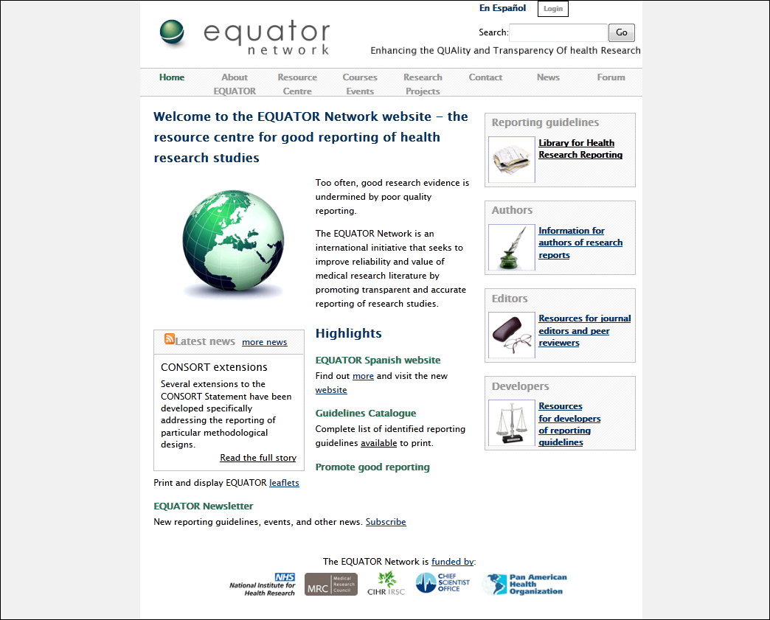

Slide 16
State of play
Not all research is published
Research reports are seriously inadequate
Improvement over time is slow
Reporting guidelines exist for most research types
Have been shown to improve reporting
Endorsement by journals is quite good for CONSORT, not good otherwise
Adherence is not very good
No incentives for researchers to adhere

Slide 17
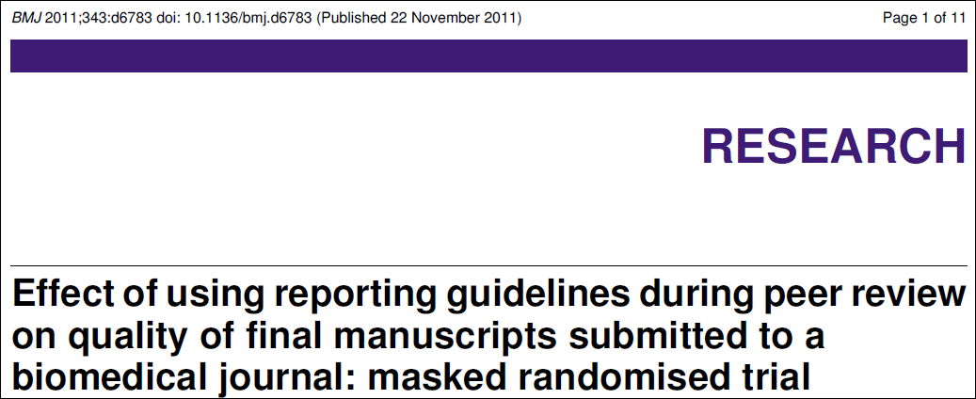
Cobo et al, BMJ 2011
“Additional reviews based on reporting guidelines improve manuscript quality, although the observed effect was smaller than hypothesised and not definitively demonstrated.”

Slide 18
What is needed?
Authors should be aware of ethical/moral responsibility to publish their findings
Honestly and transparently
Authors, editors and peer reviewers should be aware of the needs of readers
Principle of reproducibility
Should be includable in a future systematic review
Be aware of, and follow, major reporting guidelines

Slide 19
Importance of good research reporting
Research reports should present sufficient information to allow a full evaluation of the presented data and further use of these findings
Good reporting is an essential part of doing good research

