Slide 1
Key reporting guidelines in detail and practical exercises:
CONSORT Statement 2010
Kenneth Schulz
FHI 360 and UNC School of Medicine
Durham and Chapel Hill, North Carolina, USA

Slide 2
History of CONSORT (Consolidated Standards of Reporting Trials)
Started with a meeting in 1993, in Ottawa, NOT for a reporting guideline
  To develop a RCT quality scale
  Mainly trialists and methodologists (Moher, Schulz, Gøtzsche, Tom Chalmers, Curt Meinert, Stuart Pocock, Dave Sackett. etc.
  No medical journal editors

Slide 3
History of CONSORT (Consolidated Standards of Reporting Trials)
Morphed into the Standards of Reporting Trials (SORT) meeting
Evidence-based, whenever possible
  Not reporting the item, compared to reporting it, was associated with bias
    e.g., Allocation concealment
Published in JAMA in 1994

Slide 4
SORT
More items, 32, compared to the eventual 22
Strict, dogmatic structure for presentation
  Debate on whether too prescriptive, cumbersome
  Drummond Rennie of JAMA suggested a test

Slide 5

Drummond decided to ask the authors of an accepted manuscript on a RCT . . .
to rewrite and reconfigure according to SORT
David and I were hesitant …
  Did not want to foment scientific enemies
Drummond said the authors live in Texas and work in different fields . . . You’ll never see them . . .

Slide 6
SORT
Experiment published
  Williams JW, Holleman DR, Samsa GP, Simel DL. Randomized controlled trial of three versus ten days of trimethoprim/sulamethoxazole for acute maxillary sinusitis. JAMA 1995;273:1015-21
Authors found the structure difficult
Drummond was right about everything but . . .
I moved
John Williams moved

Slide 7
History of CONSORT (Consolidated Standards of Reporting Trials)
Based essentially on SORT (JAMA 1994)
JAMA editorial w/ SORT (Rennie)
Working Group on Recommendations for Reporting Clinical Trials in the Biomedical Literature (Asilomar Group)
  Chicago O’Hare Hilton, 1995
Absorbed Asilomar Group
Richard Horton . . . CONSORT
CONSORT published in JAMA in 1996

Slide 8
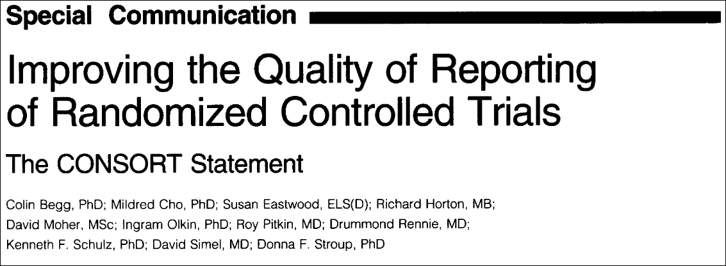
CONSORT 1996

Slide 9
Goals of CONSORT
(Consolidated Standards of Reporting Trials)
Main objective
To improve the reporting of RCTs
  Facilitates critical appraisal and interpretation
Secondary objective
To encourage the conduct of high-quality, unbiased RCTs
  Transparent reporting reveals deficiencies in research if they exist
  Indirectly improves design and conduct

Slide 10
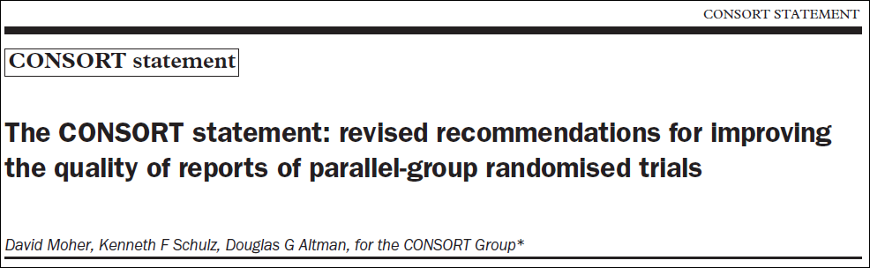

CONSORT 2001

Slide 11
2001 Revision of CONSORT
Major update published in 2001
Checklist – major revision
Also small changes to flow diagram
Short paper (“The CONSORT Statement”)
  published in 3 journals
Explanation and Elaboration (E&E)
  Detailed explanations w/ examples

Slide 12
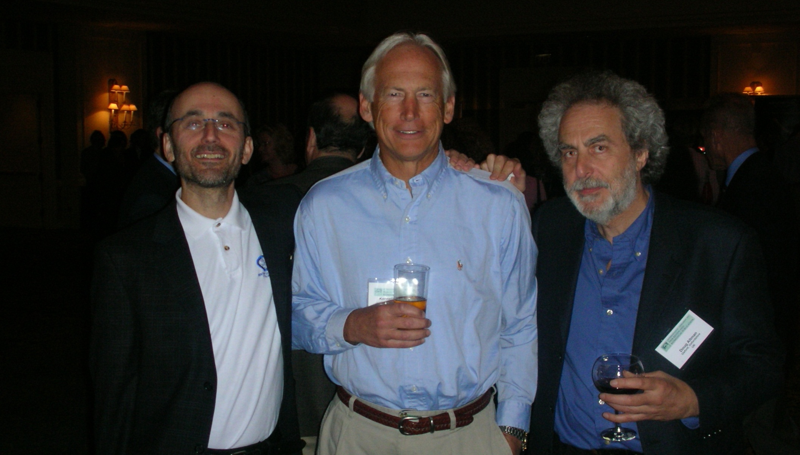
Moher, Schulz, and Altman

Slide 13
Rationale for checklist items
Necessary to evaluate the study
Evidence-based, whenever possible
Minimum set of essential items

Slide 14
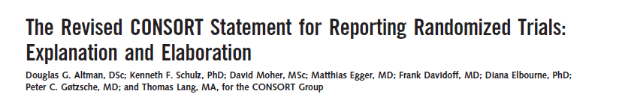
The “explanation and elaboration” manuscript
To enhance the use and dissemination of CONSORT
For each checklist item: a detailed explanation, examples of good reporting, with relevant empirical evidence

Slide 15

2010 Revision of CONSORT
Meeting in January 2007
Revised checklist
Short paper (published in 9 journals)
Revised (and expanded) explanatory paper (E&E)

Slide 16
CONSORT checklist 2010 (25 items)
TITLE & ABSTRACT
INTRODUCTION
Background
Objectives
METHODS
Trial design
Participants
Interventions
Outcomes
Sample size
Randomization
  Sequence generation
  Allocation concealment
  Implementation
Blinding (Masking)
Statistical methods
RESULTS
Participant flow
Recruitment
Baseline data
Numbers analyzed
Outcomes and Estimation
Ancillary analyses
Harms
DISCUSSION
Limitations
Generalisability
Interpretation
OTHER INFORMATION
Registration
Protocol
Funding

Slide 17
(n=…)
Assessed
for eligibility
Excluded
Not meeting inclusion criteria
Refused to participate
Other reason
Enrollment
Randomized
Allocated to intervention
Received allocated intervention
Did not receive allocated
intervention (give reasons)
Allocated to intervention
Received allocated intervention
Did not receive allocated
intervention (give reasons)
Allocation
Lost to follow up
Discontinued intervention
(give reasons)
Lost to follow up
Discontinued intervention
(give reasons)
Follow up
Analysed
Excluded from analysis
Analysed
Excluded from analysis
Analysis

Slide 18
Major changes in 2010
Added 3 new items
  Registration, Protocol, Funding
Added several sub-items, e.g.
  Any important changes to methods after trial commencement, with a discussion of reasons
  Why the trial ended or was stopped
Made some items more specific
  e.g. allocation concealment mechanism, blinding
We simplified and clarified the wording throughout
All changes are documented in the paper

Slide 19
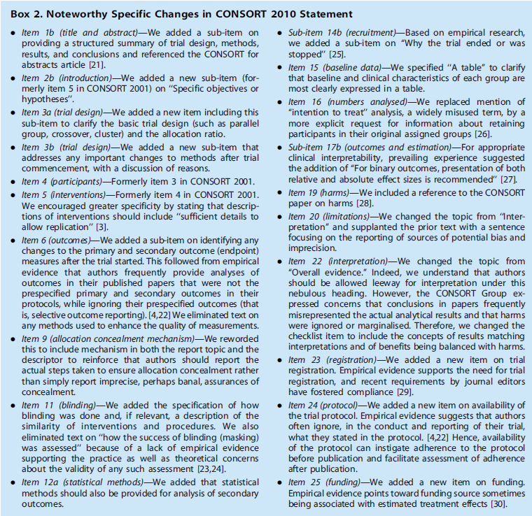

Slide 20
Blinding in CONSORT 2010
We added the specification of how blinding was done and, if relevant, a description of the similarity of interventions and procedures
We eliminated text on “how the success of blinding (masking) was assessed”
  lack of supporting empirical evidence
  theoretical concerns about the validity of such assessment

Slide 21
What do we need to know about treatment allocation?
Was the allocation sequence generated in an appropriately unpredictable way, e.g. by randomization [“Sequence generation”]
  How was the sequence determined?
Was the act of allocating a treatment to a patient done without any knowledge of what treatment they will get? [“Allocation concealment”]
  What was the mechanism of allocation?

Slide 22
Description of randomization in RCTs
So important that CONSORT checklist has 3-4 items:
Item 8a. Method used to generate the random allocation sequence
Item 8b. Type of randomisation; details of any restriction (such as blocking and block size)
Item 9. Mechanism used to implement the random allocation sequence (such as sequentially numbered containers), describing any steps taken to conceal the sequence until interventions were assigned
Item 10. Who generated the random allocation sequence, who enrolled participants, and who assigned participants to interventions

Slide 23
Good (clear) reporting
Sequence generation:
“Independent pharmacists dispensed either active or placebo inhalers according to a computer generated randomization list.” [Bolliger et al, BMJ 2000]
... The randomization code was developed using a computer random number generator to select random permuted blocks. The block lengths were 4, 8, and 10 varied randomly ...” [Coutinho et al, Obstet Gynecol 2008]

Slide 24
Clear reporting but poor methodology
“Randomization was alternated every 10 patients, such that the first 10 patients were assigned to early atropine and the next 10 to the regular protocol, etc. To avoid possible bias, the last 10 were also assigned to early atropine.”
[Lessick et al, Eur J Echocardiography 2000;1:257-62]

Slide 25
Effectiveness of antibiotic prophylaxis in preventing bacteriuria after multichannel urodynamic investigations: A blind, randomized study in 124 female patients
Am J Obstet Gynecol

Slide 26
“On completion of the procedures, the patients were randomly assigned to prophylaxis or nonprophylaxis groups according to hospital number. Both the physician and the nurse technician were blind as to which assignment the patient received. Patients in group A received nitrofurantoin 50 mg four times and phenazopyridine hydrochloride 200 mg three times for 1 day. Patients in group B received phenazopyridine hydrochloride only. The code was broken at the completion of the study.”

Slide 27
Table I. Patient demographics
 | Group A | Group B | p Value
No. of patients Age (yr) Mean Range | 49 55.29 27-77 | 53 58.58 24-81 | NS
Gravidity Mean Range | 3.04 0-10 | 3.09 0-8 | NS
Parity Mean Range | 2.43 0-8 | 2.58 0-7 | NS
Weight (kg) Mean Range | 69.89 49-98 | 69.78 50-106 | NS
Patients with infections on follow-up No. % | 4 8.2 | 10 18.9 | NS

Slide 28
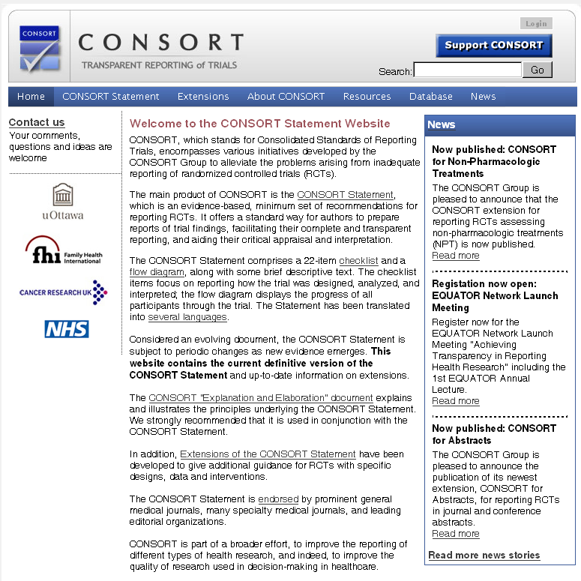
www.consort-statement.org

Slide 29
CONSORT extensions
Design
Cluster trials (Campbell)
Non-inferiority & Equivalence trials (Piaggio)
Interventions
Herbal (Gagnier)
Non-pharmacological treatments (Boutron)
Data
Harms (Ioannidis)
Abstracts
Journal and conference (Hopewell)

Slide 30
CONSORT
Practical

Slide 31
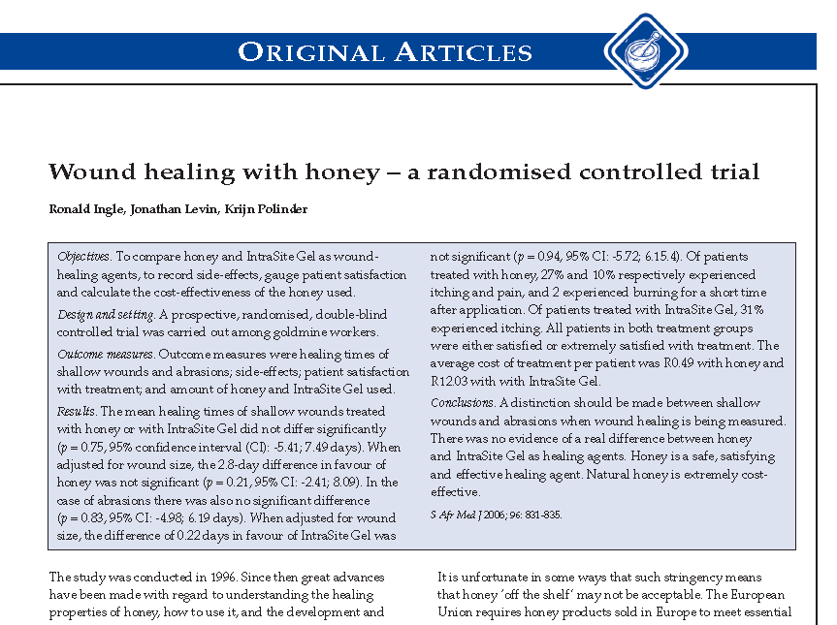

Slide 32
For each item …
Is there text relating to the item?
Does the text tell us what we need to know?

Slide 33
Interventions: Item 5
“The interventions for each group with sufficient details to allow replication, including how and when they were actually administered”
Can you locate any text about this issue in the report?

Slide 34
Interventions
“The two agents evaluated were natural monofloral aloe honey, creamed by crushing and not heated, and IntraSite Gel, a hydrogel wound-care product manufactured by Smith and Nephew Ltd. consisting of propylene lycol 20%, starch copolymer 2% and water 78%.”

Slide 35
Replicate Honey Intervention?
What is honey?
  What is the dose?
  To what extent is honey a generic substance? – antimicrobial activity can vary 100-fold
  What is influence of age, method of preparation, and handling of honey?
  Should honey be sterilised?

Slide 36
How administered
“All wounds were cleaned once daily with normal saline.
Honey was then applied with a prepacked wooden spatula, using a fresh spatula for each application.
IntraSite Gel was expressed from sterile sachets
All wounds were covered with Opsite to keep the agent in place”

Slide 37
Sample Size: Item 7
Sample size: 7a
How sample size was determined
Sample size: 7b
When applicable, explanation of any interim analyses and stopping guidelines
Can you locate any text about these issues in the report?

Slide 38
Ingle et al
“Estimation of study group size
The required size calculated for each group to detect a difference between mean healing times of 5 days was at least 40 patients, using an α-value of 0.05, power of 80%, and a standard deviation (SD) of 8 days.”

Slide 39
Randomization: Items 8 and 9
Sequence generation
8a Method used to generate the random allocation sequence
8b Type of randomization; details of any restriction (such as blocking and block size)
Allocation concealment mechanism
9 Mechanism used to implement the random allocation sequence (such as sequentially numbered containers), describing any steps taken to conceal the sequence until interventions were assigned
Any text about these issues in the report?

Slide 40
Ingle et al
“Stratified randomisation
Enrolled subjects were stratified by wound type, HIV status and the presence of slough, then randomised (using random permuted blocks of size 10) to treatment with either honey or IntraSite Gel to produce approximately equal numbers in each treatment group and an approximate balance of the 3 possible prognostic factors (Table I).”

Slide 41
Participant Flow: Item 13
Participant flow (a diagram is strongly recommended)
13a For each group, the numbers of participants who were randomly assigned, received intended treatment, and were analyzed for the primary outcome
13b For each group, losses and exclusions after randomization, together with reasons.
Any text on this issue in the report?

Slide 42
Ingle et al
No flow diagram (note: footnotes in Table 1)
“Of 87 patients enrolled, 5 were excluded from the analysis: 1 wound was misjudged as being an abrasion but there was complete skin loss, 1 was misjudged as being a shallow wound but there were islands of healing, 1 patient withdrew after 2 days for personal reasons, and 2 wounds were dressed with both agents in error. Forty wounds were treated with honey, of which 25 were shallow wounds and 15 were abrasions or partial-thickness burns. Forty-two wounds were treated with IntraSite Gel, of which 25 were shallow wounds and 17 were abrasions, donor sites or partial-thickness burns.”

Slide 43
Ingle et al

Slide 44
Outcomes and estimation: Item 17
Outcomes and estimation
17a For each primary and secondary outcome, results for each group, and the estimated effect size and its precision (e.g., 95% confidence interval).
17b For binary outcomes, presentation of both absolute and relative effect sizes is recommended
Primary outcome?
The result of the trial for the primary outcome? [estimated treatment effect and CI]

Slide 45
Item 17: Ingle et al
Primary outcome is (by implication) healing time
Top of p 833 (right column) means for both and show CI per group
  Does not give the estimated effect size (difference in means) or the CI for that difference (which can be calculated from information given)
  Strangely, the findings are given in the correct format for the subsets
  Overwhelming evidence of interaction?

Slide 46
Item 17: Ingle et al
Strangely, the findings are given in the correct format for subgroups
Is subgroup analysis proper?
  A priori?
  Overwhelming evidence of effect modification
    Test of interaction?
Incorrect labeling in Figure 3 for agent

Slide 47
Other considerations
Blinding
  Who?
  Possible?

Slide 48
END

