Slide 1
Improving the reporting of randomised trials: CONSORT Statement and beyond
Doug Altman
The EQUATOR Network
Centre for Statistics in Medicine, Oxford, UK

Slide 2
“The whole of medicine depends on the transparent reporting of clinical trials”
Drummond Rennie, JAMA 2001

Slide 3
“This leads one to consider if it is possible, in planning a trial, in reporting the results, or in assessing the published reports of trials, to apply criteria which must be satisfied if the analysis is to be entirely acceptable….
“A basic principle can be set up that … it is at least as important to describe the techniques employed and the conditions in which the experiment was conducted, as to give the detailed statistical analysis of results.”
“If cases are allotted to a control group or to a treatment group … what method of random selection is used?”
[Daniels M. Scientific appraisement of new drugs in tuberculosis. Am Rev Tuberc 1950;61:751-6.]

Slide 4
Daniels M. Clinical evaluation of chemotherapy in tuberculosis. Br Med Bull 1951;7:320-6.

Slide 5
“… editors could greatly improve the reporting of clinical trials by providing authors with a list of items that they expected to be strictly reported.”
[DerSimonian R et al, NEJM 1982]

Slide 6
CONSORT 1996

Slide 7
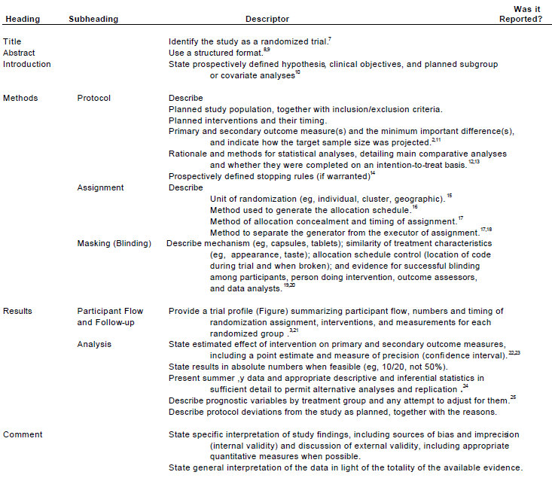

Slide 8
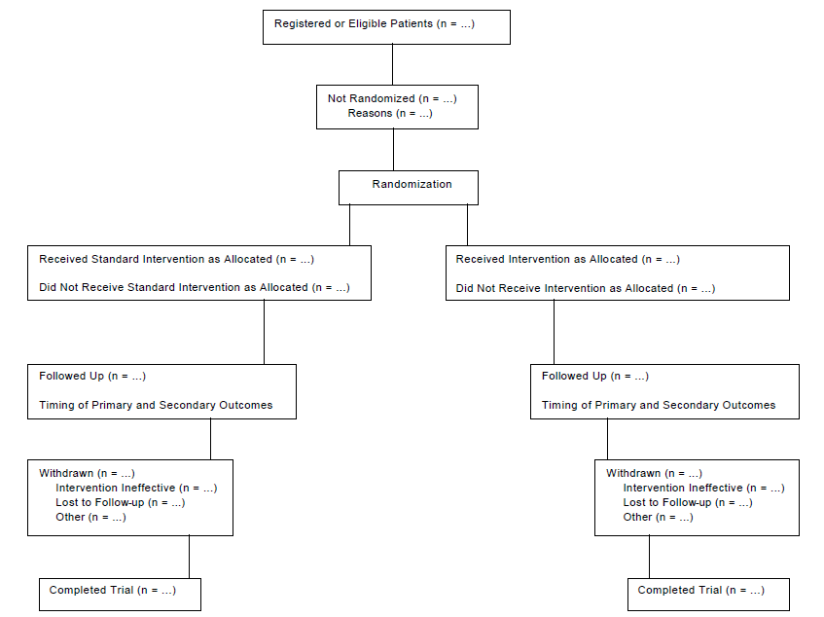

Slide 9
2001 Revision of CONSORT
Major revision begun in 2000 – published in 2001
Checklist – major revision
Also small changes to flow diagram
Short paper (“The CONSORT Statement”)
published in 3 journals
Explanatory paper (E&E)

Slide 12
Rationale for checklist items
Necessary to evaluate the study
Evidence-based, whenever possible
Minimum set of essential items

Slide 13
The “explanation and elaboration” manuscript
To enhance the use and dissemination of CONSORT
For each checklist item: examples of good reporting and explanation, with relevant empirical evidence

Slide 14
CONSORT Extensions to other trials designs
Modifications to and possibly additions to the checklist items
Possibly also modification of the flow diagram.
Extensions were planned for 6 trial designs
cluster randomised trials
non-inferiority and equivalence trials
multi-arm parallel group trials
crossover trials
factorial trials
within-person randomised trials
Also in development
N-of-1 trials

Slide 15
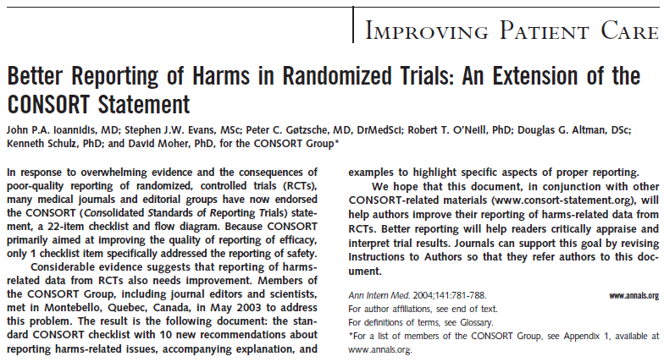

Slide 16
Reporting of adverse events in RCTs of HAART: systematic review. [Chowers et al. J Antimicrob Chemother 2009]
Only 16/49 trials reported AEs with no pre-selection
67% reported only some AEs
e.g. the most frequent, if P<0.05, or ‘selected’ AEs
“These facts obstruct our ability to choose HAART based on currently published data.”
“Authors and editors should ensure that reporting of AEs in HAART trials follows the CONSORT guidelines for reporting on harms in randomized trials.”

Slide 17
Implementations of CONSORT
Acupuncture (STRICTA)
Herbal medicines
Pragmatic trials
Non-pharmacological treatments

Slide 19
2010 Revision of CONSORT
Meeting in January 2007
Revised checklist
Short paper (published in 9 journals)
Revised (and expanded) explanatory paper (E&E)

Slide 20
Major changes in 2010
Added 3 new items
Registration, Protocol, Funding
Added several sub-items
e.g. any important changes to methods after trial commencement, with a discussion of reasons
Made some items more specific
e.g. allocation concealment mechanism, blinding
We simplified and clarified the wording throughout
NB Changes are documented in paper

Slide 21
Blinding in CONSORT 2010
We added the specification of how blinding was done and, if relevant, a description of the similarity of interventions and procedures
We eliminated text on “how the success of blinding (masking) was assessed”
lack of empirical evidence supporting the practice
theoretical concerns about the validity of such assessment

Slide 22
Evolution of the CONSORT Statement
Outcomes
CONSORT 1996
“Primary and secondary outcome measure(s) …”
CONSORT 2001
“Clearly defined primary and secondary outcome measures …”
CONSORT 2010
“Completely defined prespecified primary and secondary outcome measures, including how and when they were assessed”

Slide 23
Evolution of the CONSORT Statement
Interventions
CONSORT 1996
“Planned interventions and their timing”
CONSORT 2001
“Precise details of the interventions intended for each group and how and when they were actually administered”
CONSORT 2010
“The interventions for each group with sufficient details to allow replication, including how and when they were actually administered”

Slide 24
What do we need to know about treatment allocation?
Was the allocation sequence generated in an appropriately unpredictable way, e.g. by randomization [“Sequence generation”]
How was the sequence determined?
Was the act of allocating a treatment to a patient done without any knowledge of what treatment they will get? [“Allocation concealment”]
What was the mechanism of allocation?

Slide 25
Description of randomization in RCTs
So important that CONSORT checklist has 3-4 items:
Item 8a. Method used to generate the random allocation sequence
Item 8b. Type of randomisation; details of any restriction (such as blocking and block size)
Item 9. Mechanism used to implement the random allocation sequence (such as sequentially numbered containers), describing any steps taken to conceal the sequence until interventions were assigned
Item 10. Who generated the random allocation sequence, who enrolled participants, and who assigned participants to interventions

Slide 26
Good (clear) reporting
Sequence generation:
“Independent pharmacists dispensed either active or placebo inhalers according to a computer generated randomization list.”
... The randomization code was developed using a computer random number generator to select random permuted blocks. The block lengths were 4, 8, and 10 varied randomly ...”

Slide 27
Clear reporting but poor methodology
“Randomization was alternated every 10 patients, such that the first 10 patients were assigned to early atropine and the next 10 to the regular protocol, etc. To avoid possible bias, the last 10 were also assigned to early atropine.”
[Lessick et al, Eur J Echocardiography 2000;1:257-62]

Slide 28
Clear reporting?
“Patients were assigned to either the intervention or control group, by selection of a card from a pile of equal numbers of cards for each group.”
[Lancet 2002; 360: 1455–61.]

Slide 29
The Post-It method of allocation
“The sequence was created on a pad of Post-It notes by a person who never had patient contact.
“Group assignment was made according to the next Post-It note by on-site personnel enrolling the patient. Assignment was made after the patient agreed to participate in the trial and the on-site personnel were not aware of the assignment until that time (blinded).
“The Post-It notes were kept in a closed envelope on site by the investigator/enrolment team.
“We've found this to be a straightforward, uncomplicated, user-friendly and efficient way to have the randomization implemented.”

Slide 30
“Randomization was alternated every 10 patients, such that the first 10 patients were assigned to early atropine and the next 10 to the regular protocol, etc. To avoid possible bias, the last 10 were also assigned to early atropine.”

Slide 31
Concealed allocation?
“Randomization was carried out by having prepared in advance a small box with 50 identically sized pieces of paper folded so that they could not be read. 25 had A and 25 had B written on them. The box was shaken and one of the pieces of paper was removed from the box blindly.”
[Coan et al (1980) cited by van Tulder et al. Spine 1999.]

Slide 32
“They were randomised by selecting from random numbers held in sealed envelopes”
“Randomisation was performed in advance with a random number table by a hospital pharmacist not involved in the study, and treatment allocations were sealed in opaque envelopes. Investigators were blind to these allocations.”

Slide 33
Comparing trial publications with protocols – sample size and analysis
Unacknowledged discrepancies between protocols and publications
sample size calculations (18/34 trials),
methods of handling protocol deviations (19/43)
missing data (39/49),
primary outcome analyses (25/42)
subgroup analyses (25/25)
adjusted analyses (23/28)
Interim analyses were described in 13 protocols but mentioned in only five corresponding publications
[Chan et al, BMJ 2008]

Slide 34
Lancet 1999; 353: 490-3
“Electronic publication of a protocol could be simply the first element in a sequence of “threaded” electronic publications, which continues with reports of the resulting research (published in sufficient detail to meet some of the criticisms of less detailed reports published in print journals), followed by deposition of the complete data set.”

Slide 35
Sharing data is not a new idea
“Experience has shown the advantage of occasionally rediscussing statistical conclusions, by starting from the same documents as their author. I have begun to think that no one ought to publish biometric results, without lodging a well-arranged … copy of his data in some place where it should be accessible, under reasonable restrictions, to those who desire to verify his work.”
Galton F. Biometrika 1901
“…the data of almost any laboratory worker, if he conscientiously describes his technique and material, have considerable value for an indefinite period.”
Dunn HL. Physiol Rev 1929

Slide 36
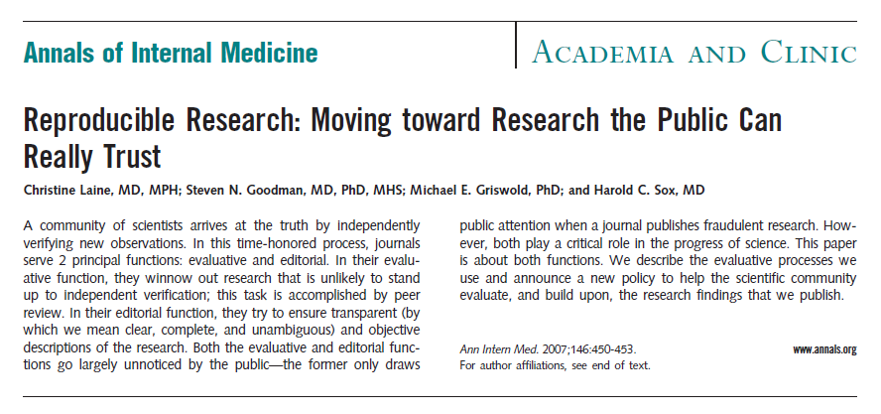

Slide 37
www.consort-statement.org

