Slide 1
What are reporting guidelines
Iveta Simera
The EQUATOR Network workshop
October 2013
Notes:
I

Slide 2
Reporting guidelines
Focus on scientific content of the article
Specify a minimum set of items required for a clear and transparent account of what was done and what was found in a research study
Reflect in particular issues that might introduce bias into the research
Moher et al. PLoS Med 2010

Slide 3
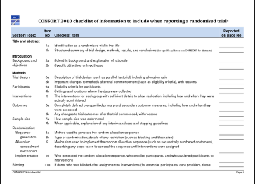
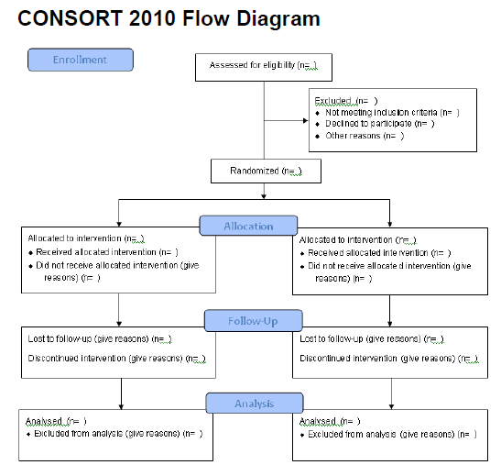
Reporting guidelines (2)
Form:
structured advice, often as a checklist (perhaps also a flow diagram)
Most internationally accepted RGs
Based on evidence
Consensus of relevant stakeholders (multidisciplinary group)

Slide 4
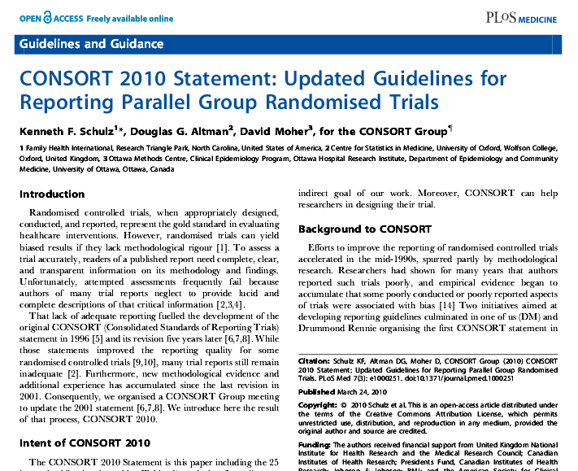
Different focus
STUDY DESIGN / METHODOLOGY
Main study designs / types (generic guidelines)
More specialised designs
Specific methods, evaluations, analyses
Core RG
(“Must”)

Slide 5
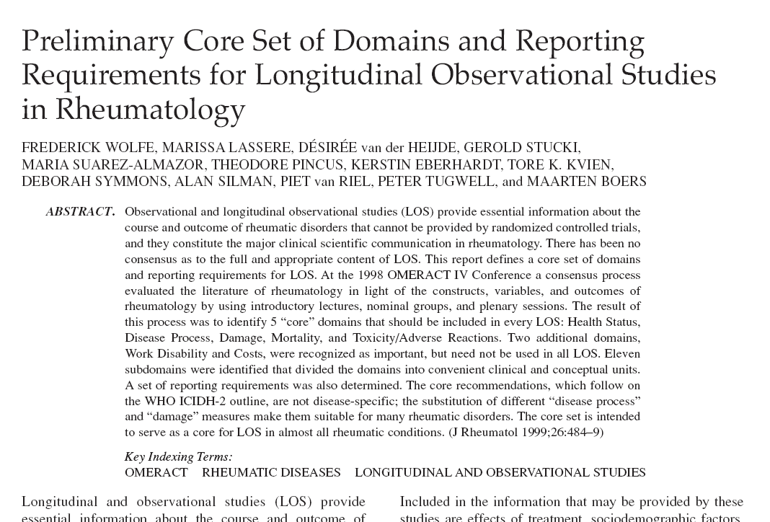
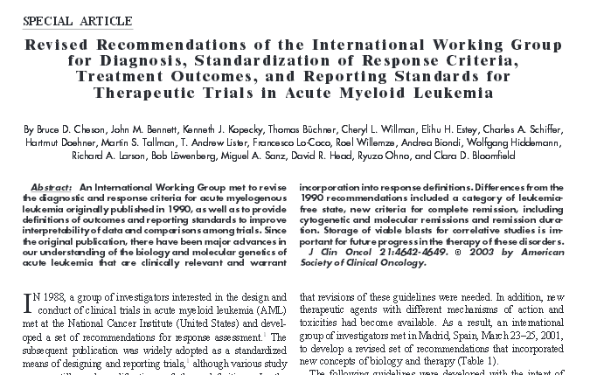
Different focus (2)
SPECIFIC DISCIPLINE / CLINICAL AREA
Different ‘degree’ of specificity
May or may not address general methodology items
May focus on a complete research study / paper or only on a part
Should be used with relevant generic methodology guidelines as they often focus only on content specifics

Slide 6
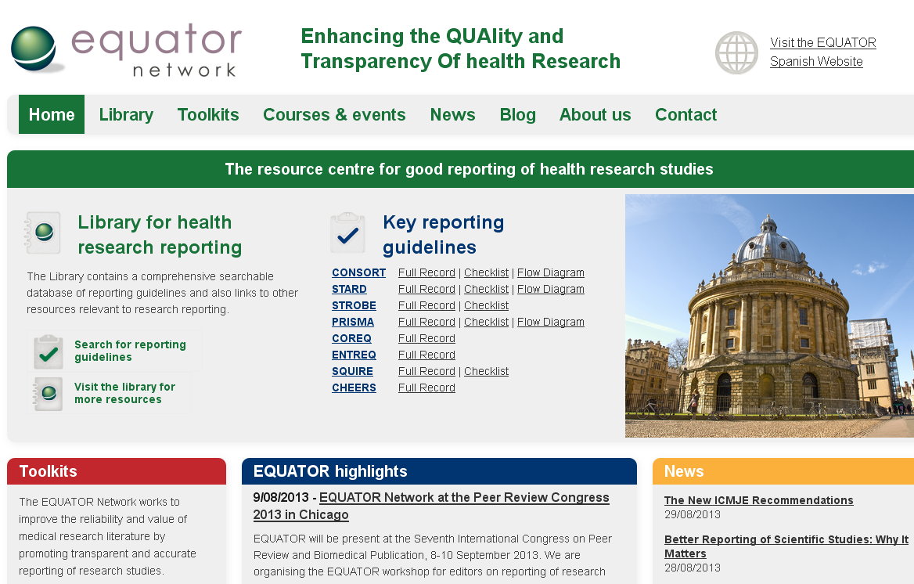
EQUATOR website

Slide 7
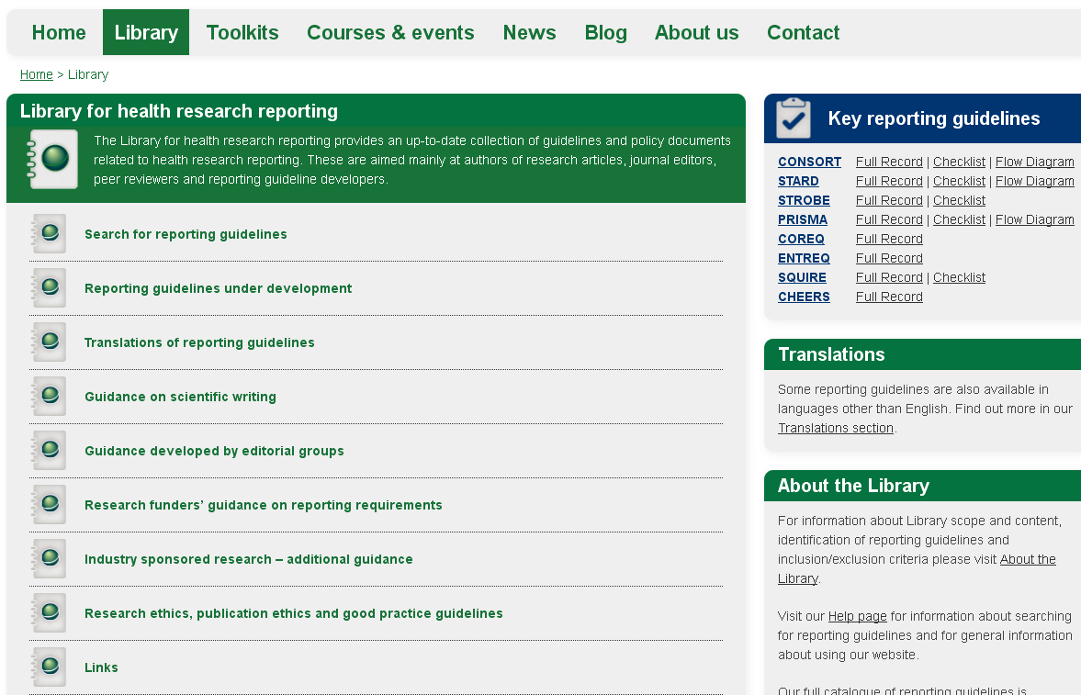
Library for health research reporting

Slide 8
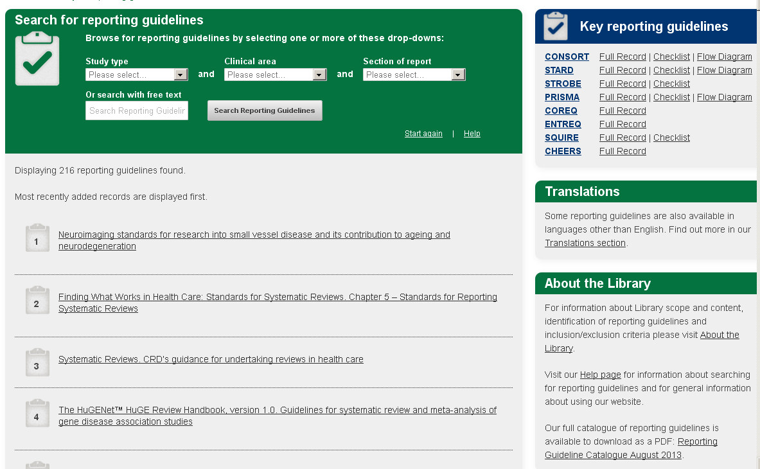
Reporting guidelines database

Slide 9
www.equator-network.org

