Slide 1


The EQUATOR Network
Library for Health Research Reporting
Iveta Simera
The EQUATOR Network workshop
10 October 2012, Freiburg, Germany
Notes:
I

Slide 2
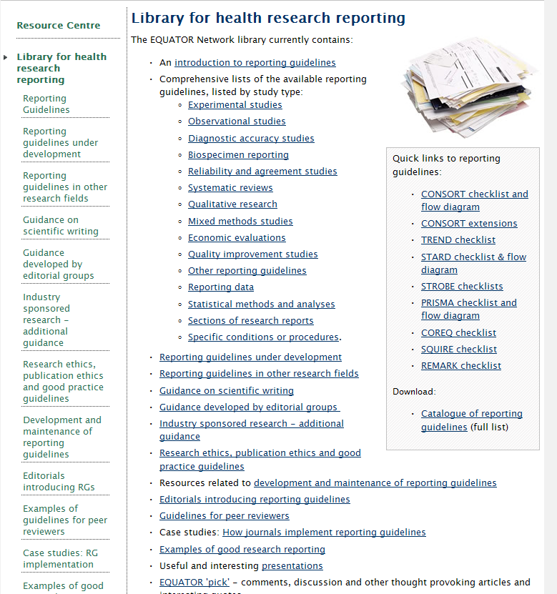
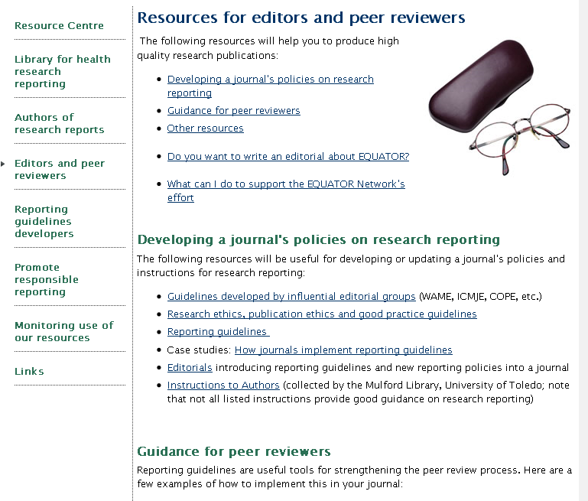
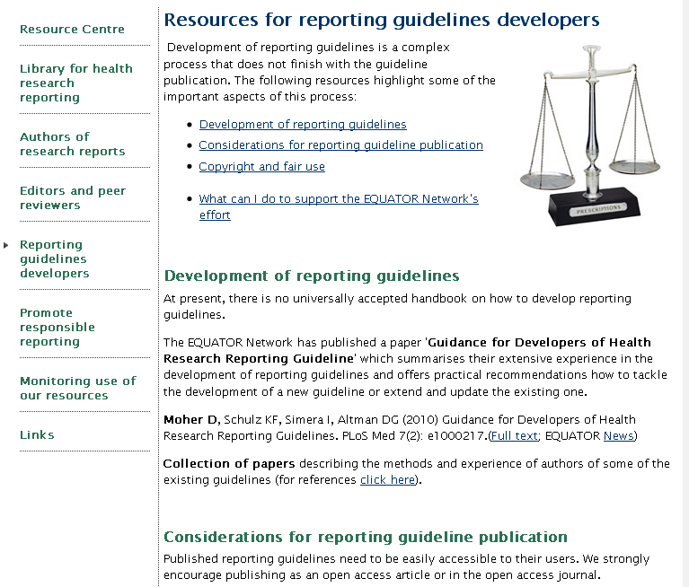
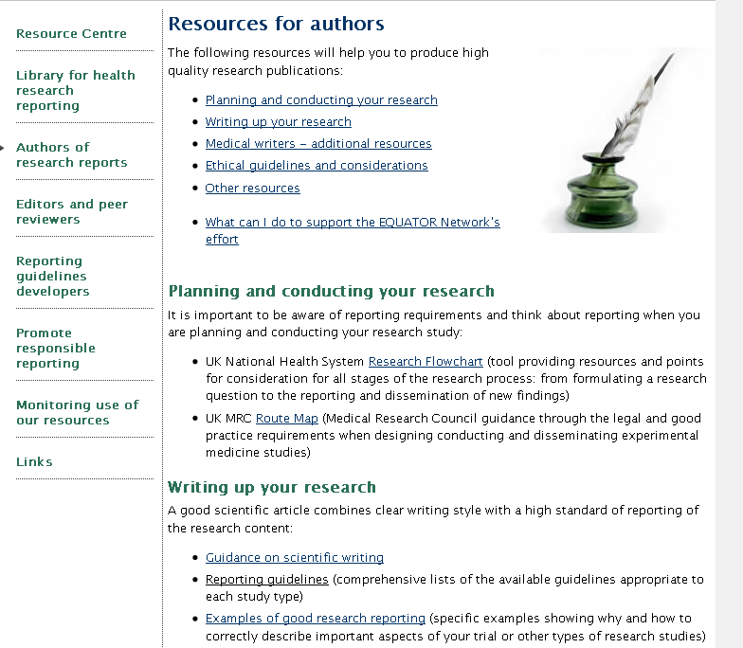
EQUATOR online resources
All collated resources are available in our Library
Some of the resources are grouped according to relevance to our main user groups

Slide 3
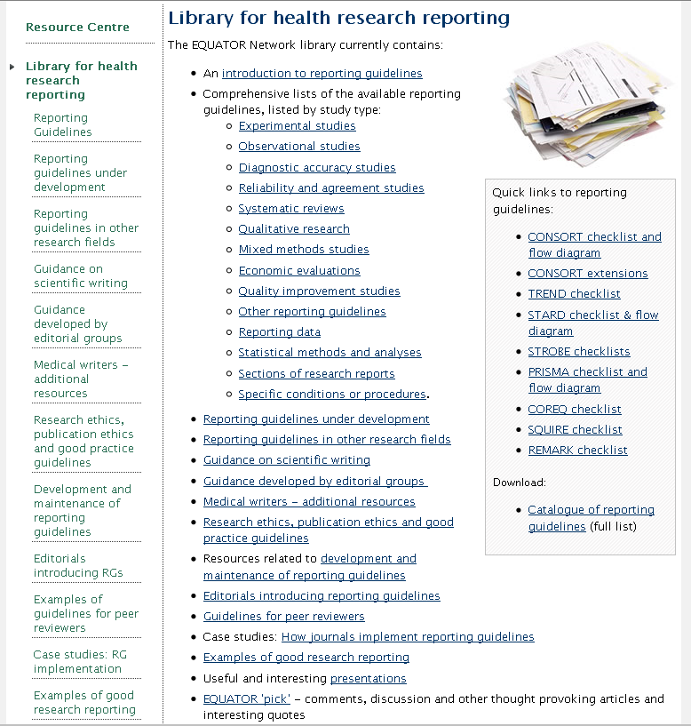
EQUATOR Library – resources (1)
Reporting guidelines
  Key (box on right side)
Reporting guidelines under development
Sections of research reports (figures, graphs, COI, etc.)
Statistical methods & analyses
Guidance on scientific writing
Guidance on research & publication ethics, good practice, etc.
www.equator-network.org

Slide 4
EQUATOR Library – resources (2)
Guidance for specific user groups:
  Industry sponsored research (medical writers)
  Guidance developed by editorial groups
Editors
  Editorials introducing RG
  Guidelines for peer reviewers
  Examples from journals
  How to select suitable RG
Authors
  Guidance on scientific writing
  Links to resources on research design, conduct, etc.
RG developers
www.equator-network.org

Slide 5
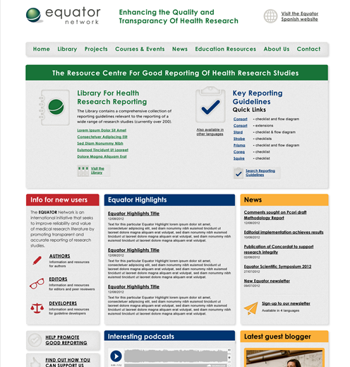
EQUATOR website re-design

Slide 6
Closing thoughts
Reporting guidelines are helpful tools when used correctly and at right time
Read Explanation and Elaboration papers of the main generic reporting guidelines – good learning source about general principles!
Carefully select which reporting guidelines you should use for your research
Even if your target journal does not require compliance with any reporting guidelines - select and follow those suitable for your study
Have a browse through the EQUATOR website to see what is available

