Slide 1
Transparency and accuracy in reporting health research
Doug Altman
The EQUATOR Network
Centre for Statistics in Medicine, Oxford, UK

Slide 2
Transparency and value
Research only has value if
Study methods have validity
Research findings are published in a usable form

Slide 3
Research article
A published research article is often the only permanent record of a research study
Some readers might be satisfied with scanning an article, or a brief summary
Others will study it in detail for possible inclusion in a systematic review or to influence a clinical practice guideline
Only an adequately reported research study can be fully appraised and used appropriately
to assess reliability and relevance

Slide 4
Research article
Readers need a clear understanding of exactly what was done and what was found
Clinicians, Researchers, Systematic reviewers, Policy makers, …
The goals should be transparency and accuracy
Should allow replication (in principle)
Can be included in systematic review and meta-analysis
Should not mislead

Slide 5
What do we mean by poor reporting?
Key information is missing, incomplete or ambiguous
methods and findings
Misrepresentation of the study
Misleading interpretation
Of particular concern
Non-publication of whole studies
Selective reporting of methods or findings

Slide 6
Taxonomy of poor reporting
Non-reporting Failure to publish a report of a completed study (even if was presented at a conference)
Selective reporting Biased reporting of data within a published report
Incomplete reporting Key information is missing
Misleading presentation e.g. claiming study is an RCT when it isn’t; post hoc change of focus (spin)
Inconsistencies between sources e.g. publication conflicts with protocol
All are very common

Slide 7
Incomplete reporting of research is very common
Hundreds of published reviews show that key elements of trial methods and findings are commonly missing from journal reports
We often cannot tell exactly how the research was done
These problems are generic
not specific to randomised trials
not specific to studies of medicines
not specific to commercially sponsored research

Slide 8
Incomplete reporting of research is very common
“In 37% of papers patient numbers were inadequately reported;
20% of papers introduced new statistical methods in the ‘results’ section not previously reported in the ‘methods’ section, and
23% of papers reported no measurement of error with the main outcome measure.”
[Parsons et al, J Bone Joint Surg Br 2011]

Slide 9
5/228 trials (2%) met all 7 CONSORT criteria reviewed.
52% specified a primary outcome
43% reported attrition (loss to follow up)
36% reported information about blinding
28% described randomization scheme
27% described allocation concealment
22% described an adequate power calculation

Slide 10
Ecological studies
The quality of modern cross-sectional ecologic studies: a bibliometric review [Dufault & Klar, Am J Epidemiol 2011]
N=125
“Most investigators who adjusted their outcomes for age or sex did so improperly (64%)
Statistical validity was a potential issue for 20% of regression models
Many authors omitted important information when discussing the ecologic nature of their study (31%), the choice of study design (58%), and the susceptibility of their research to the ecological fallacy (49%).”

Slide 11
“Spin”
Review of breast cancer trials
“… spin was used frequently to influence, positively, the interpretation of negative trials, by emphasizing the apparent benefit of a secondary end point. We found bias in reporting efficacy and toxicity in 32.9% and 67.1% of trials, respectively, with spin and bias used to suggest efficacy in 59% of the trials that had no significant difference in their primary endpoint.”
[Vera-Badillo et al, Ann Oncol 2013]

Slide 12
Inconsistency between sources
Comparison of content of RCT reports in surgical journals and trial registry entries (n=51)
[Rosenthal & Dwan, Ann Surg 2013]
 | Primary | Secondary
No discrepancy | 55% | 33%
Complete omission | 8% | 31%
New introduction | 8% | 39%
Change in definition | 10% | 6%
Downgrading from primary to secondary | 22%
Upgrading from secondary to primary | 14%

Slide 13
Consequences of inadequate reporting
Assessing the reliability of published articles is seriously impeded by inadequate reporting
Clinicians cannot judge whether to use a treatment
Data cannot be included in a systematic review
Serious consequences for clinical practice, research, policy making, and ultimately for patients

Slide 14
Poor reporting is a serious problem for systematic reviews and clinical guidelines
“Risk of bias assessment was hampered by poor reporting of trial methods.”
[Meuffels et al. Computer assisted surgery for knee ligament reconstruction, CDSR 2011]
“Poor reporting of interventions impeded replication”
[Gordon and Findlay. Educational interventions to improve handover in health care: a systematic review. Med Educ 2011]
“15 trials met the inclusion criteria for this review but only 4 could be included as data were impossible to use in the other 11.”
[Nolte et al. Amphetamines for schizophrenia. CDSR 2004]
“Poor reporting of data meant that individual effect size could not be calculated for any of these studies.”
Bleakley et al. Some conservative strategies are effective when added to controlled mobilisation with external support after acute ankle sprain: a systematic review. Aust J Physiother 2008.

Slide 15
We need research we can rely on
“Assessment of reliability of published articles is a necessary condition for the scientific process”
[Ziman. Reliable Knowledge, 1978]
“… clinical research involving human participants can only be justified ethically when such experiments are done to produce generalizable knowledge.”
[Korn & Ehringhaus. PLoS Clin Trials 2006]
Authors (and journals) have an obligation to ensure that research is reported adequately
Notes:
Poor reporting makes the assessment of methodological quality of study very difficult.
If the infomation is not present in the publication the reader is left to assume – e.g. not properly reported includion / exclusion criteria in the trial – how much are the results relevant for a patient with a particular disease
Good reporting should not be regarded as something new and extra. It is the final and intergral part of the research study.
Authors (and journals, and I’ll come back to that) have an obligation to ensure that research is reported adequately.

Slide 16
Reporting research is not new concern, but it is a relatively neglected one
“… incompleteness of evidence is not merely a failure to satisfy a few highly critical readers. It not infrequently makes the data that are presented of little or no value.”
[Mainland. The treatment of clinical and laboratory data, 1938]

Slide 17
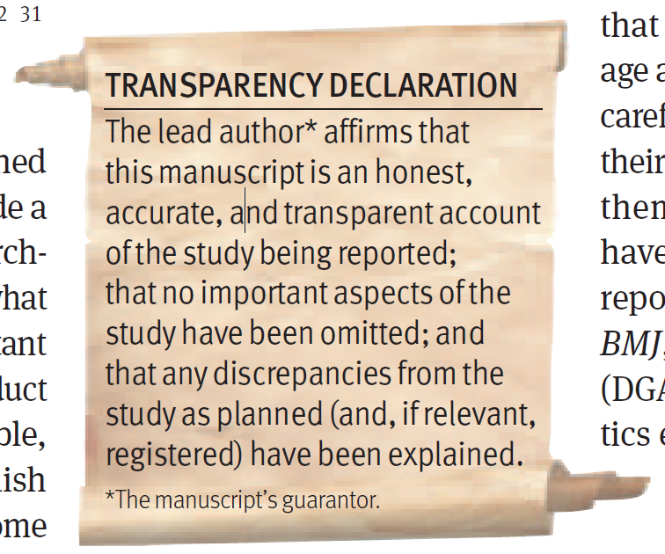
[Altman and Moher, BMJ 2013]

